Slide 1
ASR
Automatic Speech Recognition
Preraphan Srirojanapinyo 6081124
Thanyaluck Suthanarak 6081277

Slide 2
Automated speech recognition (ASR) is a technology that allows users of information systems to speak entries rather than punching numbers on a keypad. ASR is used primarily to provide information and to forward telephone calls.
Notes:
Automated speech recognition (ASR) refers to technologies built to process human speech and turn it into text which is a technology that allows users of information systems to speak entries rather than punching numbers on a keypad.ASR is used primarily to provide information and to forward telephone calls. So, the basic ASR systems will recognize single-word entries such as yes-or-no responses and spoken numerals.
Still, the ASR system cannot always correctly recognize the input from a person who speaks with a heavy accent or dialect, and its major problems is that it cannot detect when people combine words from two languages by force of habit.

Slide 3
How the process work?
ASR software detects this speech.
Device creates a wave file of the words it hears.
Clean and delete background noise and normalize the volume.
Filtered waveform will be broken down and analyzed in sequences.
ASR will analyzes these sequences and employs statistical probability to determine the whole words and then complete sentences.
Notes:
An individual or a group speaks and an ASR software detects this speech.
The device then creates a wave file of the words it hears.
The wave file is cleaned to delete background noise and normalize the volume.
This filtered waveform is then broken down and analyzed in sequences.
The automatic speech recognition software analyzes these sequences and employs statistical probability to determine the whole words and then complete sentences.
Some technology providers check the ASR’s work with professional human transcribers who correct any errors to achieve greater accuracy.

Slide 4
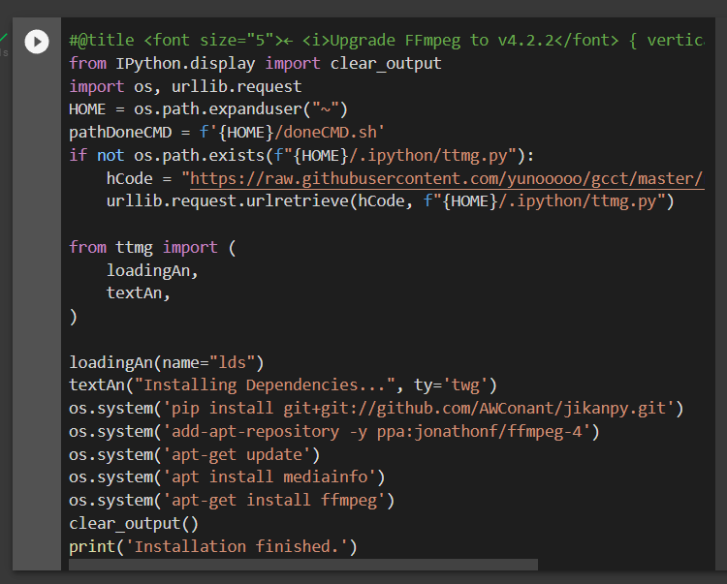
import and install FFmpeg
Notes:
We are going through the step how to use google colab to convert audio file into text. First we start by import and install the ff/m/peg to the notebook.

Slide 5

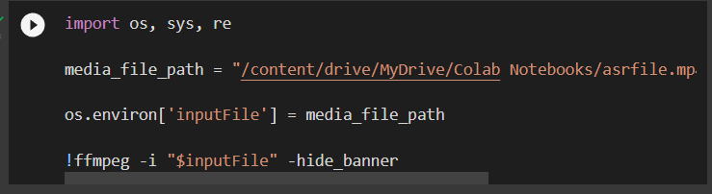
Mount google drive
Link video from google drive to google colab
Notes:
Next we mount google drive and link video from google drive to google colab

Slide 6
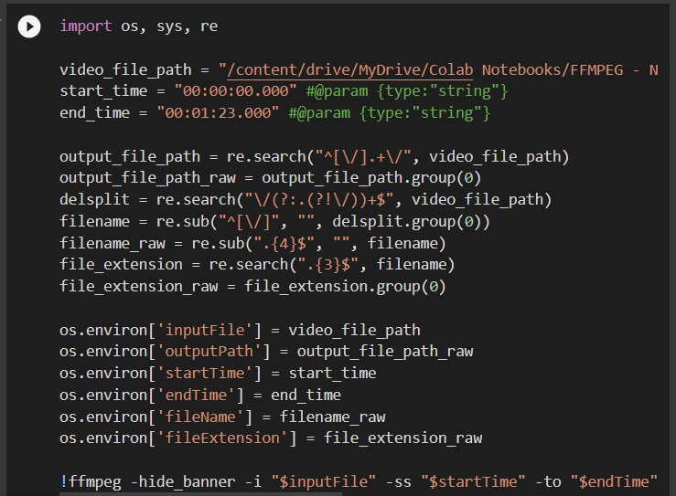
Trim the video file into 1 min 23 seconds
Notes:
Then we trim down our video to around 1.23 sec per video

Slide 7
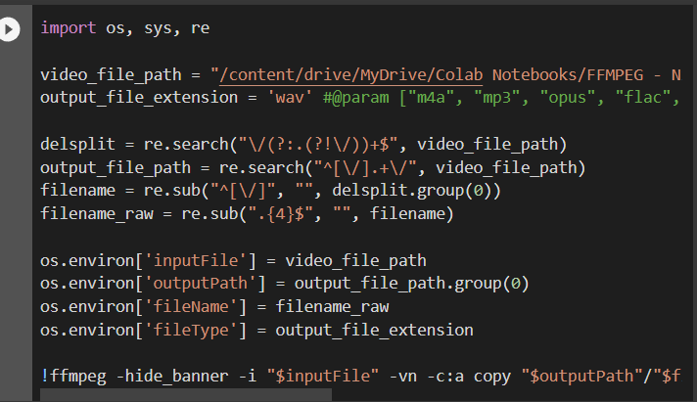
Extract wav audio file from video
Notes:
After that we extract audio file as wav file from video

Slide 8
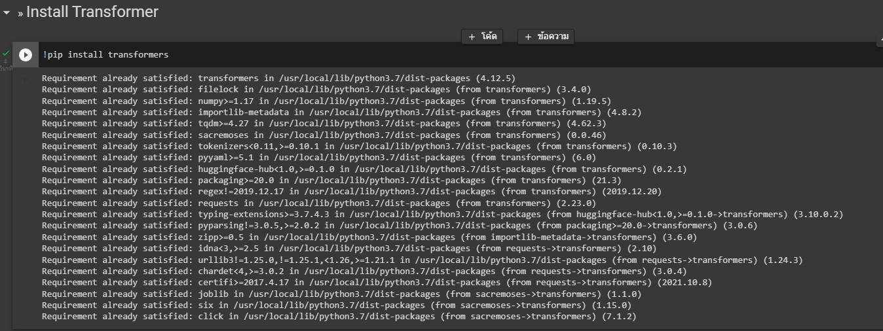
Install transformer

Slide 9
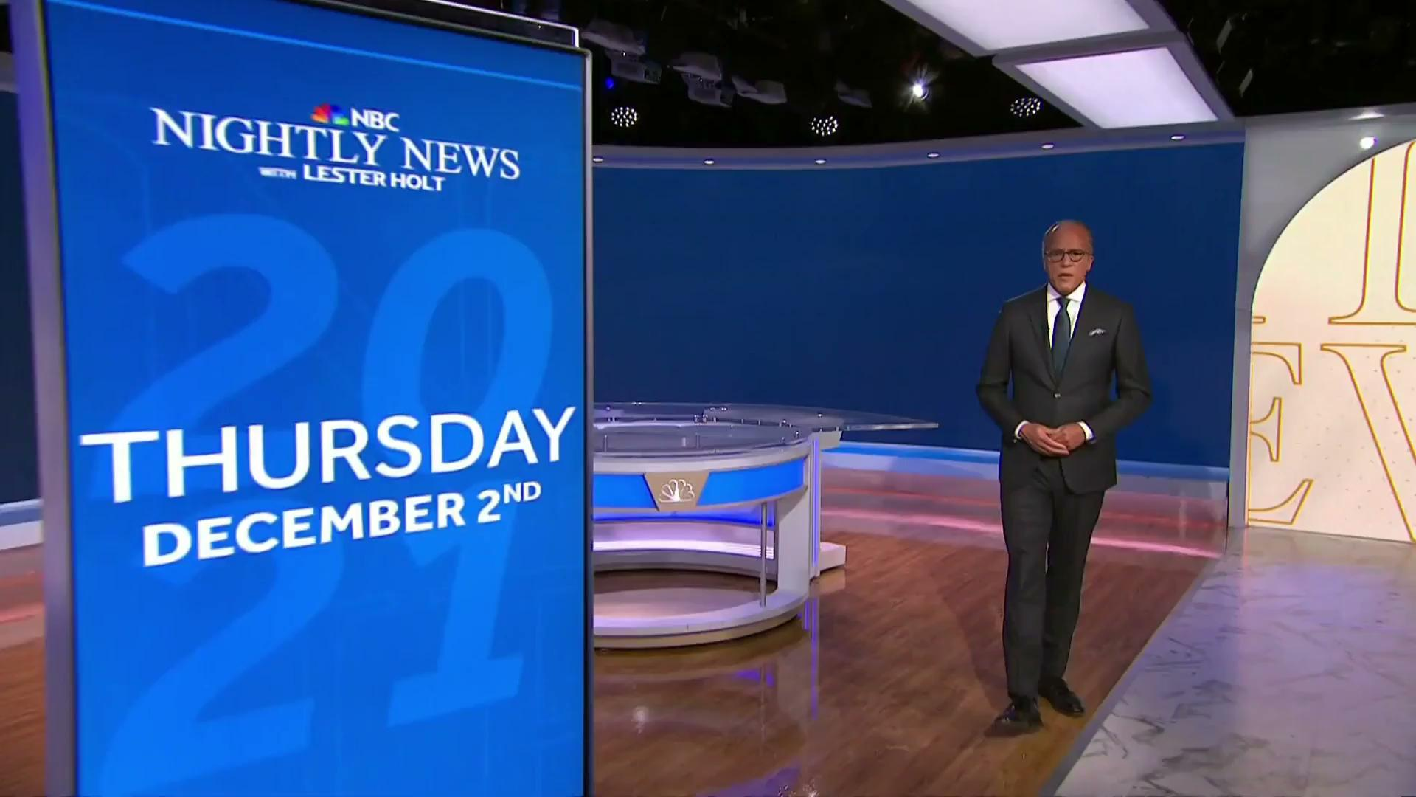
Video that we choose

Slide 10
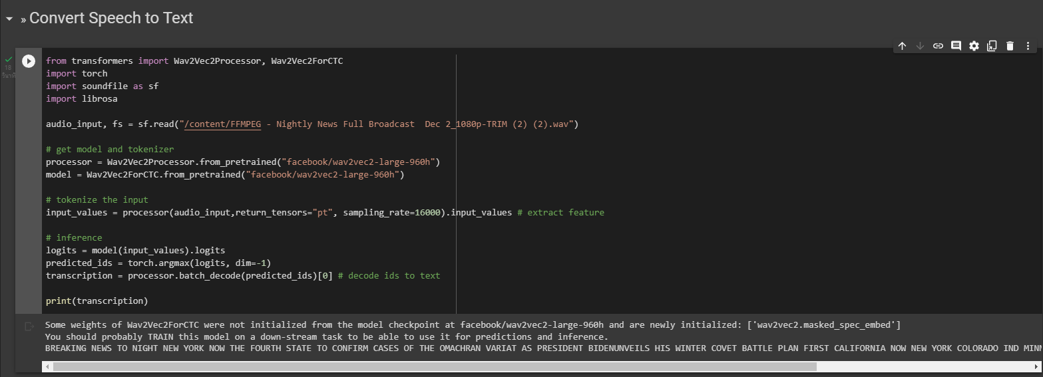
Convert speech into text

Slide 11
Text that we get from audio

Slide 12
Thank you for your attention

